Slide 1

From Shelves to Streams: Reimagining Movie Rentals
A Data-Driven Strategy for Rockbuster Stealth LLC
Presented by:
Arpita Nandy
May 2, 2025

Slide 2

Introduction
Rockbuster Stealth LLC: Global movie rental company
Facing disruption from Netflix, Amazon Prime
Goal: Launch an online video rental platform
Approach: Data-driven insights for strategic decisions

Slide 3
Project Objectives
Which movies contributed the most/least to revenue gain?
What was the average rental duration for all videos?
Which countries are Rockbuster customers based in?
Where are customers with a high lifetime value based?
Do sales figures vary between geographic regions?

Slide 4
Data Overview
Data loaded into relational database (RDBMS)
Key tables: Inventory, Rentals, Customers, Locations, Payments
Tools:
SQL for analysis
Excel for summarization and visualization
Tableau for visualization

Slide 5
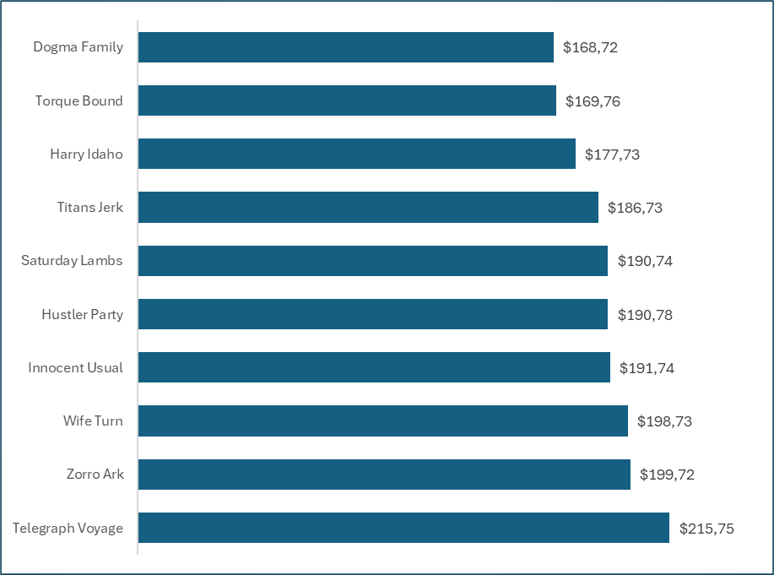
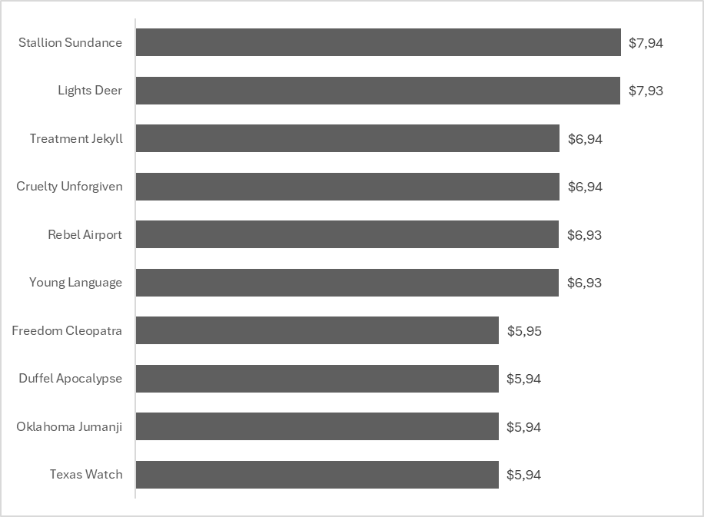
Revenue Analysis
Top revenue-generating titles
Underperforming titles

Slide 6
Rental Behavior
On average customers rented movies for 5 days with rental period ranging from 3-7 days

Slide 7
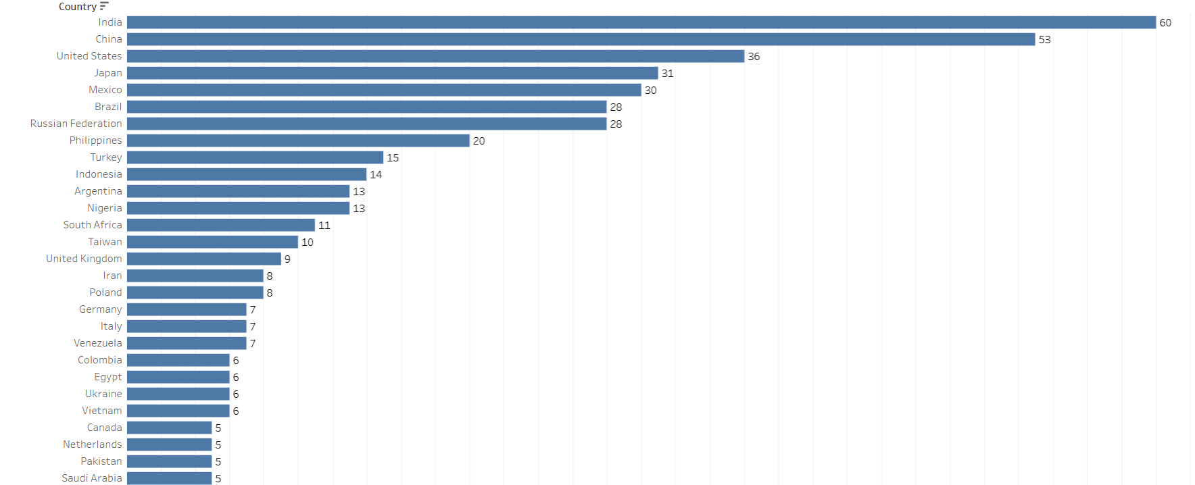
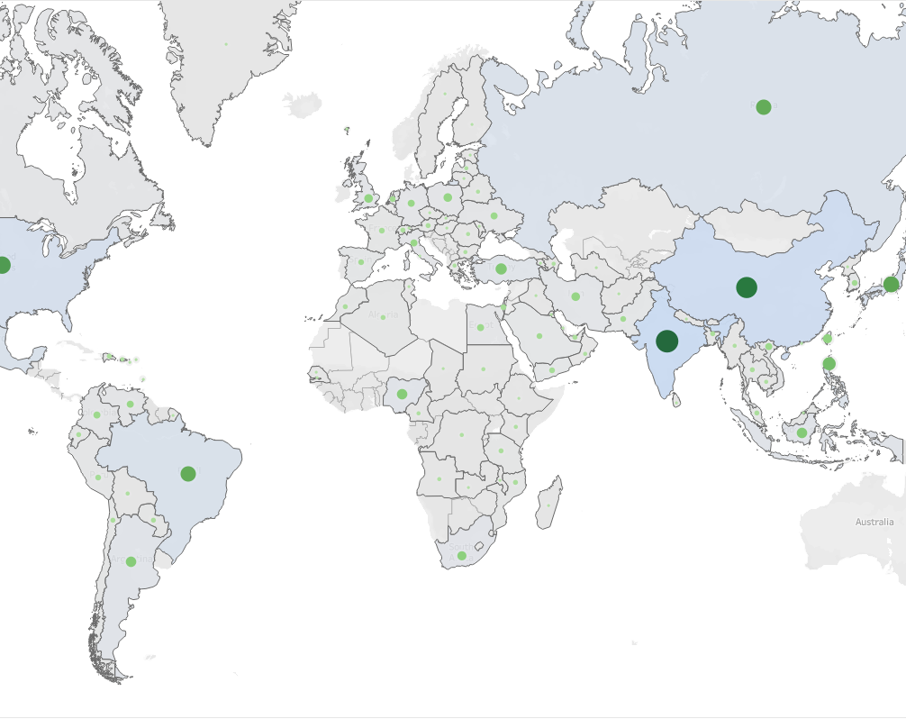
Customer Geography
India and China have the highest number of customers.

Slide 8
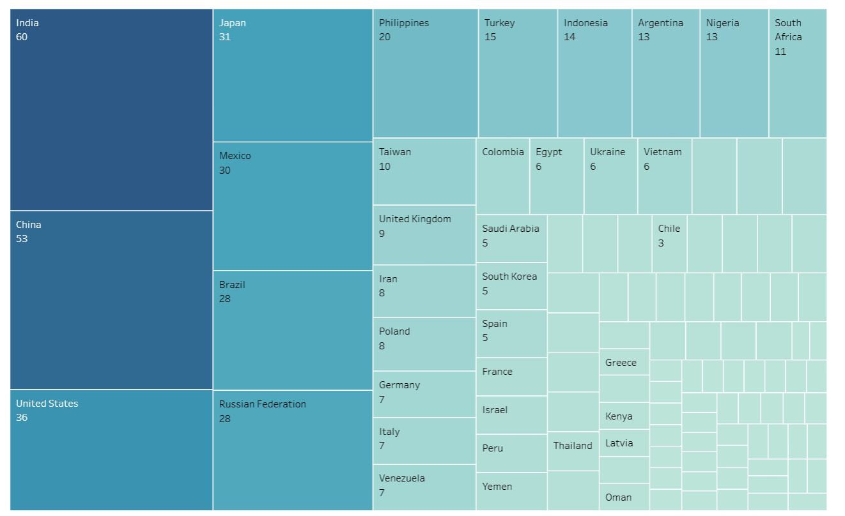
High Value Customers
High value customers spend over $100 on movie rentals

Slide 9
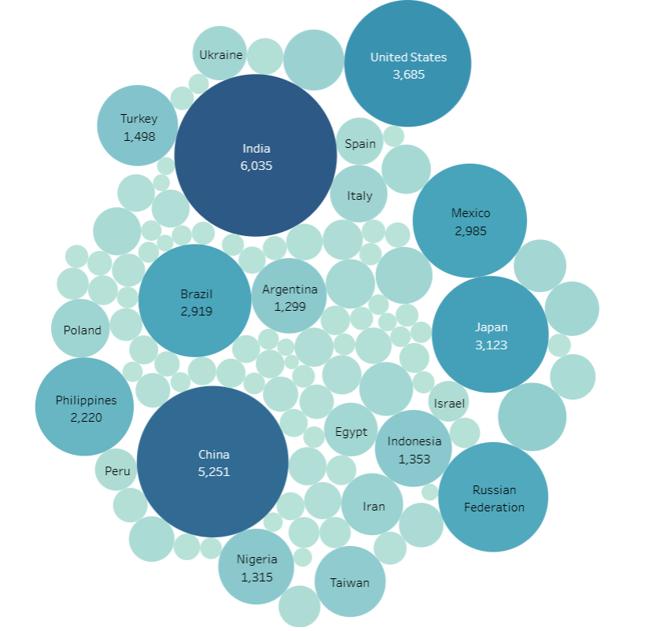
Regional Sales Comparison
Highest blockbuster profits come from Asia and North America

Slide 10
Strategic Recommendations
• Promote high-revenue titles and genres
• Focus launch in top-performing countries
• Personalized outreach for high-LTV users
• Encourage short rentals to boost engagement

Slide 11
Next Steps
Launch platform and monitor kpis
Expand catalog based on viewer data
Explore local partnerships for faster streaming
Evaluate quarterly performance metrics

Slide 12


Tableau Link
https://public.tableau.com/app/profile/arpita.nandy/viz/Ecercise3_10_ArpitaN/CustomerLocation2?publish=yes

Slide 13
Q&A
Let’s Stream the Questions
🎬

Slide 14

Thank You!

